Slide 1

CAGAYAN STATE UNIVERSITY · CARIG CAMPUS
THESIS RESEARCH PRESENTATION
Development of a Localized
Real-Time Frequency Monitoring System
for Structural Health Monitoring Using MEMS IMUs and ESP32-S3
Jan Clyde T. Talosig
Bachelor of Science in Electronics Engineering · September 2026
Adviser: Engr. Christopher R. Capili, MSECE

Slide 2
01 · THE STORY
From a local bridge problem to a measurable research question
A simple path through the thesis
1
2
3
4
THE PROBLEM
THE QUESTIONS
THE EVIDENCE
THE APPROACH
Bridge deterioration and failure can have consequences between inspection intervals.
What should be measured, and what can this study realistically establish?
Prior SHM research supports vibration monitoring, MEMS sensing, FFT analysis, and field observation.
Build the system, observe Buntun Bridge, extract frequency, and establish an internal baseline.
Presentation Roadmap
Thesis Research Presentation · 2026
2

Slide 3
CHAPTER I · BACKGROUND
Why this research matters
The problem begins with what happens when bridges are monitored too late
REGION 2
Two bridge failures made the monitoring problem impossible to ignore.
CABAGAN–STA. MARIA BRIDGE
PIGGATAN BRIDGE
Collapsed in February 2025 after an overloaded dump truck crossed the bridge; six people were injured and a major river crossing was severed.
Collapsed in October 2025 as overloaded trucks crossed during harvest season; seven people were injured and travel between communities was disrupted.
THE LESSON
Periodic inspection provides snapshots. The research asks whether a low-cost, continuous or repeated vibration measurement can add quantitative information between those snapshots.
Background of the Study
Thesis Research Presentation · 2026
3

Slide 4
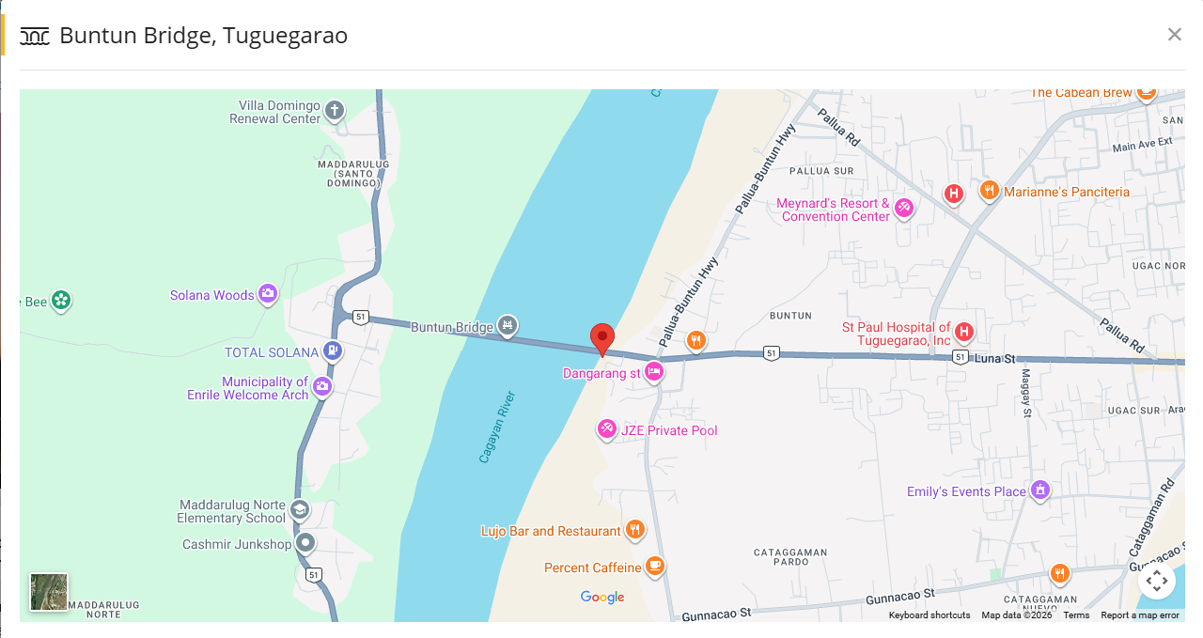
CHAPTER I · LOCAL CONTEXT
Why Buntun Bridge?
A critical, aging, operating bridge makes the study relevant and field-based
1969
1,369 m
15 tons
in service
bridge length
2025 load restriction
WHY IT FITS THE STUDY
Continuous vehicular activity provides real service excitation.
The bridge has documented deterioration and operational restrictions.
The study can observe actual vibration without imposing abnormal loads.
BUNTUN BRIDGE · TUGUEGARAO CITY, CAGAYAN
Actual operating bridge selected for field testing under naturally occurring traffic excitation.
Study Area
Thesis Research Presentation · 2026
4

Slide 5
CHAPTER I · THE PROBLEM
What is missing?
The research problem is not simply “build a sensor.” It is “build a useful reference from a bridge with no prior instrumented baseline.”
CURRENT CONDITION
THE RESEARCH RESPONSE
Monitoring is largely periodic and inspection-based.
Buntun Bridge has no prior instrumented frequency baseline available to this study.
Imported frequency-monitoring systems can be costly and difficult to deploy widely.
Develop a localized, low-cost, real-time frequency-monitoring system and use it to establish an internal baseline of Buntun Bridge dominant vibration frequencies under normal traffic conditions.
What the paper explicitly avoids
No structural damage diagnosis
No load-capacity assessment
No universal safety threshold
Statement of the Problem
Thesis Research Presentation · 2026
5

Slide 6
CHAPTER I · SOP + OBJECTIVES
Statement of the Problem & Objectives
Each question is paired directly with what the study intends to accomplish
STATEMENT OF THE PROBLEM
OBJECTIVES
How can a real-time frequency monitoring system be developed to acquire and process structural vibration data?
Develop a real-time monitoring system capable of acquiring and processing structural vibration data from Buntun Bridge.
1
1
How effectively can dominant structural frequencies be extracted from vibration signals under varying excitation and noise conditions?
Extract and establish a baseline range of dominant structural frequencies from acquired vibration signals under varying traffic conditions.
2
2
How can the system provide real-time monitoring and visualization of structural vibration characteristics?
Develop a real-time visualization interface for displaying structural vibration characteristics and frequency behavior.
3
3
Statement of the Problem & Objectives
Thesis Research Presentation · 2026
6

Slide 7
CHAPTER I · FRAMEWORK
Why frequency can tell us something about a structure
The theoretical basis is simple: structural dynamic behavior depends on mass, stiffness, and boundary conditions
STRUCTURAL IDEA
WHAT THIS MEANS FOR THIS STUDY
Changes in structural condition can change dynamic characteristics.
Measure the bridge response while it is in service.
Observe how dominant frequency behaves under different traffic conditions.
Use repeated observations to establish the bridge’s own empirical reference.
↓
mass + stiffness
dynamic response
Interpretation boundary
Frequency-based SHM uses measured vibration behavior as an indirect indicator of structural change. But frequency shift alone does not identify a unique defect.
A frequency change is a reason to look closer — not a diagnosis by itself.
Conceptual / Theoretical Basis
Thesis Research Presentation · 2026
7

Slide 8
CHAPTER I · IPO
Conceptual Framework — Input → Process → Output
The framework connects the real bridge response to the final monitoring information
INPUT
PROCESS
OUTPUT
Traffic-induced excitation
Bridge vibration
Triaxial acceleration
Raw MEMS IMU signals
Acquire + check signal
Remove bias / detrend
FFT transformation
Peak-frequency extraction
Compare with baseline
Dominant frequency
Baseline range
Traffic-aware interpretation
Web visualization
Session record
→
→
The bridge itself is the real-world input; the study contributes the acquisition, processing, baseline and visualization pipeline.
Conceptual Framework
Thesis Research Presentation · 2026
8

Slide 9
CHAPTER II · RRL
Supporting Research — What the literature already validates
The study is built on established ideas, not on an isolated hardware claim
RESEARCH FINDING
WHY IT MATTERS HERE
SUPPORTING SOURCES
Vibration-based SHM
Modal and frequency changes are established features for structural characterization.
Das et al. (2016); Avci et al. (2021); Azhar et al. (2024)
Operational Modal Analysis
Bridge vibration can be observed under ambient / operating loads without controlled excitation.
Chen et al. (2017); Hasani & Freddi (2023)
Low-cost MEMS sensing
Low-cost accelerometers can support bridge vibration and eigenfrequency estimation when installation and measurement limitations are controlled.
Komarizadehasl et al. (2022a,b); Giermann et al. (2025)
FFT / frequency analysis
FFT is widely used to convert sampled vibration signals into frequency-domain information for spectral interpretation.
Hasani & Freddi (2023); Chen et al. (2017)
Operational variability
Traffic and environmental conditions can change measured modal frequencies and therefore matter when building a baseline.
Sohn (2007); Zhou & Sun (2019); Wang et al. (2022)
Review of Related Literature
Thesis Research Presentation · 2026
9

Slide 10
CHAPTER II · RRL
Philippine Research & the Local Gap
Local studies show feasibility; they also show why field characterization matters
PHILIPPINE EXAMPLES
THE LOCAL GAP
1
Gaviña et al. (2017)
SmartBridge sensor nodes demonstrated acceleration sensing, wireless communication and online monitoring on existing Philippine bridges.
The literature reviewed does not provide a directly equivalent field methodology that combines:
2
Payawal et al. (2017)
MEMS accelerometer readings were compared with theoretical outputs, highlighting the need for calibration / field characterization.
low-cost MEMS sensing
embedded FFT-based dominant-frequency extraction
repeated traffic-condition sessions
an empirical baseline for Buntun Bridge
3
Lau et al. (2018)
Acceleration measurements were incorporated into a fuzzy-based structural health rating for Zamora Bridge.
4
PCIEERD — USHER
A Philippine institutional project combines accelerographic sensing, web access and natural-frequency recording for structural monitoring.
STUDY FIT
An applied field implementation that connects established SHM concepts to a specific Philippine bridge.
National / Local Literature & Synthesis
Thesis Research Presentation · 2026
10

Slide 11
CHAPTER III · METHODS
How the study answers the questions
A repeated-measures field approach turns the research questions into observable steps
Prepare & authorize
Process every session the same way
1
4
Site permission, safety, hardware and software checks
Preprocess → FFT → fixed peak-picking rule
Measure on Buntun Bridge
Build the baseline
2
5
Fixed sensor location, orientation and acquisition settings
Combine valid session frequencies and describe their spread
Repeat by traffic condition
Compare & interpret
3
6
Peak and off-peak sessions; record actual traffic observations
Repeatability + traffic-condition statistics; conservative interpretation
Methodology Overview
Thesis Research Presentation · 2026
11

Slide 12
CHAPTER III · FIELD WORK
Data Gathering — what happens during one session?
The unit of observation is one valid measurement session
1
2
3
4
5
PRE-FIELD
AT SITE
OBSERVE
ACQUIRE
ACCEPT / REPEAT
Charge, verify firmware, IMU communication, sampling / FFT settings, clock and field log.
Inspect safe area, install IMU, record location/orientation, perform stationary check.
Classify peak or off-peak window; record actual traffic observations and unusual events.
Run the vibration record for the predetermined duration without changing setup.
Save the record, check technical validity, then repeat across planned sessions.
Sampling target
At least 5 valid sessions per primary traffic condition; weekday/weekend balance when feasible. The target is a methodological goal, not a universal statistical requirement.
Data Gathering Procedure
Thesis Research Presentation · 2026
12

Slide 13


CHAPTER III · DATA ANALYSIS
From vibration signal to dominant frequency
The mathematics is used to make the measurement consistent and repeatable
Frequency-bin spacing
Signal
→
Preprocess
→
FFT
→
Band
→
Peak
$$∆f=\frac{f_{s}}{N}$$
x[n]
remove mean / detrend
X[k]
0 Hz + out-of-band removed
largest valid peak = fᵈ
where fₛ is the sampling frequency and N is the FFT record length.
Frequency at bin k
$$f_{k}=k\left( \frac{f_{s}}{N} \right)$$
Dominant frequency fᵈ is the frequency corresponding to the largest valid spectral peak within the predefined analysis band.
Signal Processing & Frequency Extraction
Thesis Research Presentation · 2026
13

Slide 14


CHAPTER III · BASELINE
How repeated readings become an empirical baseline
The baseline belongs to this bridge, this setup, and this monitoring period
SESSION-LEVEL FREQUENCIES
Mean → central tendency
Standard deviation → observed spread
CV → relative variation
f₁ f₂ f₃ … fₙ
MEAN
$$\bar{x}=\sum{\frac{f_{i}}{n}}$$
IMPORTANT
Outside the empirical interval = flag for review, not proof of structural damage.
BASELINE INTERVAL
x̄ − s ≤ baseline ≤ x̄ + s
Because there is no external reference system for this bridge, the baseline is internal—not a certified accuracy benchmark and not a universal safety threshold.
$$CV=\left( \frac{s}{\bar{x}} \right)×100\%$$
Baseline Frequency Construction
Thesis Research Presentation · 2026
14

Slide 15
CHAPTER III · VALIDATION
What can the study actually prove?
The method is deliberately matched to the evidence available
CAN SUPPORT
CANNOT CLAIM
Consistency / repeatability of the measurement procedure
Observed dominant-frequency behavior
A bridge-specific empirical baseline for the study period
Differences among documented traffic conditions
Absolute measurement accuracy without an external reference
Structural damage diagnosis from frequency shift alone
A universal frequency threshold for bridge safety
STATISTICAL COMPARISON
KEY POSITION
Repeatability is the defensible reliability target—not external accuracy.
One-way ANOVA at α = 0.05 when assumptions are reasonably supported; Kruskal–Wallis as the nonparametric alternative.
Reliability, Repeatability & Statistics
Thesis Research Presentation · 2026
15

Slide 16
CHAPTER I · SCOPE & SIGNIFICANCE
What this study contributes
Useful enough to matter, narrow enough to defend
WITHIN THE STUDY
WHY IT MATTERS
Real-time vibration acquisition
FFT-based dominant-frequency extraction
Repeated field sessions
Empirical baseline construction
Traffic-condition comparison
Web-based visualization
Adds a quantitative layer between inspections
Uses accessible, cost-efficient components
Creates a documented bridge-specific reference
Supports future monitoring and later SHM research
LIMITATION
The results are specific to Buntun Bridge and the observed monitoring period; they do not replace formal bridge inspection.
Scope, Delimitation & Significance
Thesis Research Presentation · 2026
16

Slide 17
THE RESEARCH CONTRIBUTION
A practical way to observe a bridge
and establish its own frequency reference.
MEASURE
EXTRACT
ESTABLISH
Observe Buntun Bridge in service.
Convert vibration to a repeatable frequency indicator.
Build an empirical baseline from repeated sessions.
“Because no external reference system is available, the study does not manufacture an accuracy percentage. It establishes what can be measured reproducibly and transparently from the actual bridge.”

Slide 18
KEY REFERENCES
Selected sources from the thesis RRL
Included here to show the evidence base behind the method
1
Avci et al. (2021) — Structural Health Monitoring and damage detection review.
7
Lau et al. (2018) — Fuzzy-based bridge structural health rating using accelerometer sensors.
2
Chen et al. (2017) — Operational modal analysis with inexpensive accelerometers on an eleven-span bridge.
8
Payawal et al. (2017) — MEMS accelerometer calibration through remote monitoring.
3
Gaviña et al. (2017) — SmartBridge sensor nodes for Philippine bridges.
9
Sohn (2007) — Effects of environmental and operational variability on SHM.
4
Hasani & Freddi (2023) — Operational Modal Analysis for field vibration measurements.
10
Wang et al. (2022) — Review of environmental and operational effects on modal frequency.
5
Hidalgo-Fort et al. (2024) — Low-cost edge-computing SHM for bridges.
11
Zhou & Sun (2019) — Traffic and temperature effects on bridge modal-frequency variation.
6
Komarizadehasl et al. (2022a,b) — Low-cost triaxial / wireless accelerometer systems for bridge monitoring.
Full bibliographic entries are contained in the thesis manuscript.
References
Thesis Research Presentation · 2026
18

Slide 19
Thank You
Questions & Discussion
Jan Clyde T. Talosig
Cagayan State University – Carig Campus · Bachelor of Science in Electronics Engineering

